Slide 1
Using the OpenAI API in R
Abigail Haddad
June 28, 2023
Notes:
Thanks for coming tonight. My name is Abigail, and I’m a data scientist. I’ve worked on Natural Language Processing tasks as part of a few jobs over the years, so when OpenAI came along, that quickly became a big part of my interest – like, how can we use OpenAI – and other large language models – to do various tasks where we give it some text, we ask it something like “summarize this” or “is this is a data science job posting?” and it gives us an answer that we can then evaluate.
That’s not exactly the task we’ll be talking about tonight, but that’s how I got into using the OpenAI – or, if you want, the OpenAI – API.

Slide 2
Takeaways
When using a single prompt across different pieces of text, use the OpenAI API
Notes:
This is what I want you to take away from this presentation. If you have a task that might be suitable for OpenAI, but it’s repetitive – like, you want to do the same type of thing over and over, with different pieces of text – then you might be interested in the OpenAI API.
There are a couple of different R libraries you can use for this; I used the openAI library.

Slide 3
Generating fake resumes
Inputs:
“generate a resume” prompt
.csv file that I wrote with fake names, academic backgrounds, and bios
Outputs:
Fake resumes for each fake candidate
Notes:
The task I’m going to talk about is generating fake resumes.
This is part of a larger project where I then wanted to see if I could get OpenAI to accurately do what’s called a “binary classification” task – that is, to label resumes as “good” or “bad” for a hypothetical data science job, and to classify them the same way I would.
Because I wanted to be able to share this project, I needed fake data, because I didn’t want to share real peoples’ resumes and say, like, “oh, that’s a bad resume.” (Or even “that’s a good one”)
I also wanted to mimic the range of resumes I saw for data scientist jobs when I was assisting with the technical side of hiring for data science jobs in the federal government. There’s a really broad range of resumes there.
My “inputs” for this project were a prompt I wrote that basically says: make me a fake resume, and then also, I make a csv file where each row had a fake name, academic background, and bio – so each row was the data for a separate fake person.
My output – the thing I used R and OpenAI to generate – was a fake resume for each fake person.

Slide 4
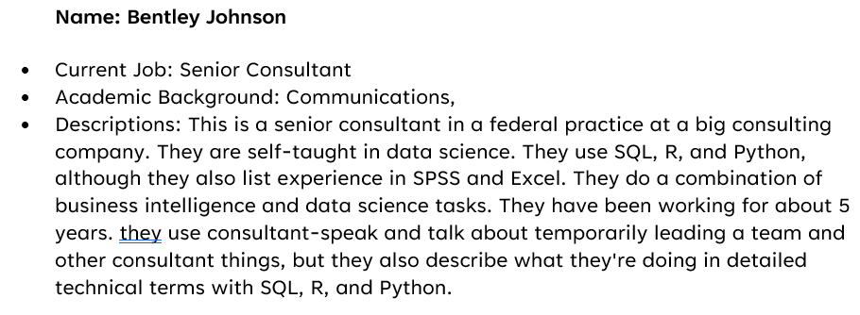
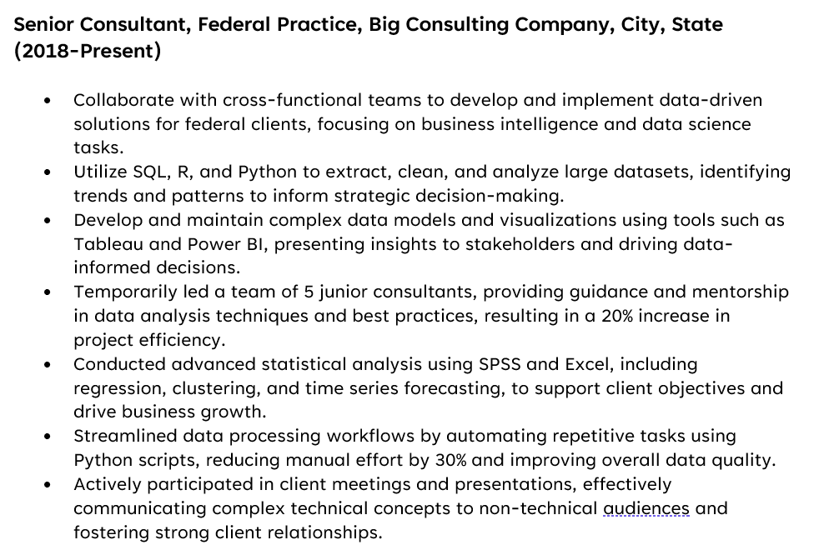
Example Input and Output
Sample Input Text
Resume Excerpt
Notes:
Here’s an example of my input text and an excerpt for the resume output. (It doesn’t actually format it in markdown – I just added that for you all.)
You can see – I described in informal terms both what this person does but also the kind of language they use. I wrote 10 these that include all manner of folks – a budget analyst who is a SME in budget processes but not a data scientist, consultants that work in Excel vs. consultants that do data science, folks with science/engineering backgrounds, operations research folks – that’s a fairly government-specific job title. And in the data, they have all kinds of different job titles, and some of them list themselves as having skills that they don’t talk about how they’re using – so, maybe they say Python in their list of skills, but none of the tasks they list specify Python or any libraries. I was really trying to capture resumes that I have seen.
I thought the results were fairly good. It’s got that consultant-speak down. It mentions the tools I asked for in a context that makes sense. If I saw this resume, I wouldn’t think, “well, that’s obviously fake.”
And in general, I thought the outputs were pretty good – but it took a lot of futzing with the prompt to get there. Like, I had to specify, write me really detailed resumes, because otherwise it didn’t. Also, the range of resume structure was narrower than what I see in real life, and that was ok for the project I was doing – if we did need to capture the full range of resume styles, we could try to do that.

Slide 5
Process
Read in your text
Use With OpenAI API
Evaluate the Results
Get your text from your .csv file, API, etc.
Concatenate it with your prompt
Sending a block of text
Getting back a result
Putting in a table/data frame
Informally: does it look like you want?
Formally: via comparing with your ‘labeled’ data and using metrics like a confusion matrix
Notes:
These are what I’d call the three general steps of the process of using the API, iterating through different pieces of text.
First, you read in your text. In my case, it’s from a CSV, but maybe you’re getting it from an API or a series of .txt files, or wherever your text happens to live. We’re now iterating through each block of text and concatenating it with the prompt – the “make a resume” prompt, in tis case.
Next, we’re now sending that prompt to GPT via the API, and getting back a result, which we’re putting in a table or data frame.
And then finally you can evaluate the results. In this case, that was informal – I wasn’t comparing them against anything concrete, I just had a general sense in my head of what I wanted the outputs to look like.
In other cases – like, if you do have specific outputs that you’re trying to see if you can get the model to emulate, than you might do some formal comparisons. For instance, my later step of this – where I got GPT to evaluate the resumes and say yes or no – my assessment was what’s called a confusion matrix. That’s where you look at the counts of true and false positives and negatives– you’re comparing how the model did against your desired output.
And I’ll throw this in, because this is what I’m working on now. One of the interesting things about these models is that they’re not deterministic. That is, if I put in the same resume inputs 10 times, I’m going to get out 10 different responses. In this case, that’s fine – because I’m just trying to generate some responses. But let’s say I’m doing a more formal task where I want to really evaluate a model’s performance. I might actually put in the same inputs more than once, and see what the range of outputs are. And I might even decide that the number of times I run the same set of inputs through a model is actually dependent on the range of outputs I’m getting – like, I’m going to stop at a certain point, dependent on my results, in a way that’s algorithmically-decided.

Slide 6




R Code
Notes:
This is just another way of showing the process. We have a stack of data, a prompt, some R code, the API – and we get back a table.

Slide 7
Other Use Cases
Text Summarization
Classification
Named Entity Recognition
Summarize this text
Summarize this candidate’s software development background
Is this job a ‘data science’ job?
What topics is this text about?
What tools and software are in this job listing?
What locations are mentioned on this resume?
Notes:
There are a lot of Natural Language Processing use cases for OpenAI. I’ve built out examples for each of these three--- text summarization, classification, and named entity recognition.
These are all, btw, things we could do prior to GPT using different kinds of models – but with varying levels of success.
For instance, you could use a tool called Spacy for named entity recognition – and there is an R wrapper for that- and it would work REALLY well on certain kinds of entities – but less well on others.
There are text summarization tools which worked with varying levels of being good. (And some of those models might actually still be the right answer – there are lots of open source models that are cheaper to use than the GPT models)
Now, text classification was the one where GPT is, for many cases, just a huge improvement over what came prior. If you were doing a really well-trodden classification task, like sentiment analysis or topic modelling, you might have been able to get that to work out of the box .But if you were, say, trying to label data science resumes as ‘good’ or ‘bad’ – you would have been labeling thousands of resumes in order to try to get a model built. Whereas now, it’s like GPT is this pre-trained-on-everything model where you don’t have to do that.
And then, obviously, with something like generating fake resumes – I’m not sure what tool I would have used for that previously.

Slide 8
For More Information
https://github.com/abigailhaddad/resume_generation_R
Abigail@datasciencedc.org
https://presentofcoding.substack.com/
Notes:
If you want to see my code, it’s here (as are these slides). And you can definitely tweak it if you want to use a different data source/prompt.
And there’s my blog, where I write about LLMs and occasionally other more general data science topics. I’ve gone through using this with summarization and named entity recognition as well, as as well as a couple of text classification use cases, and assessment.
Questions.

